Slide 1
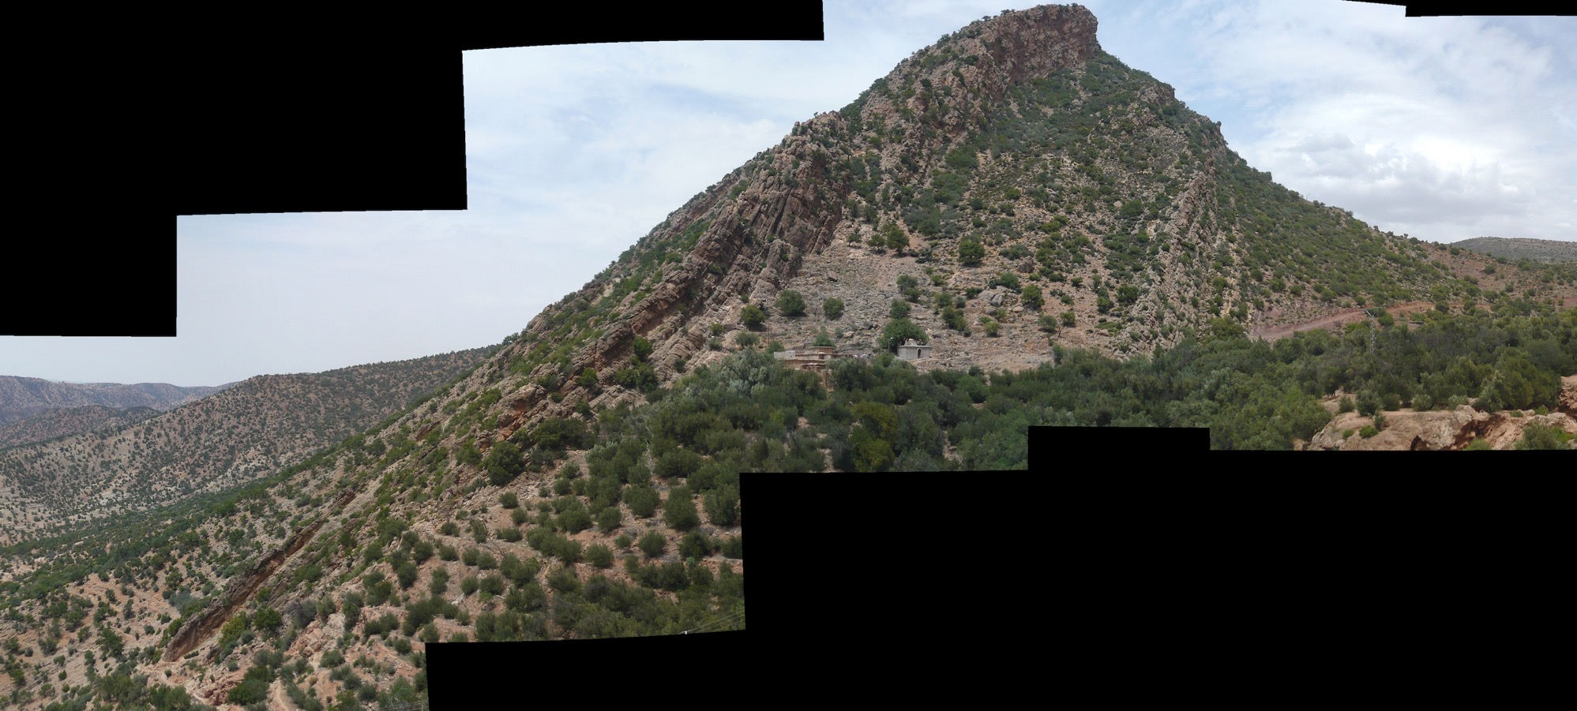
Outcrop overview
Somalirhynchia member

Slide 2
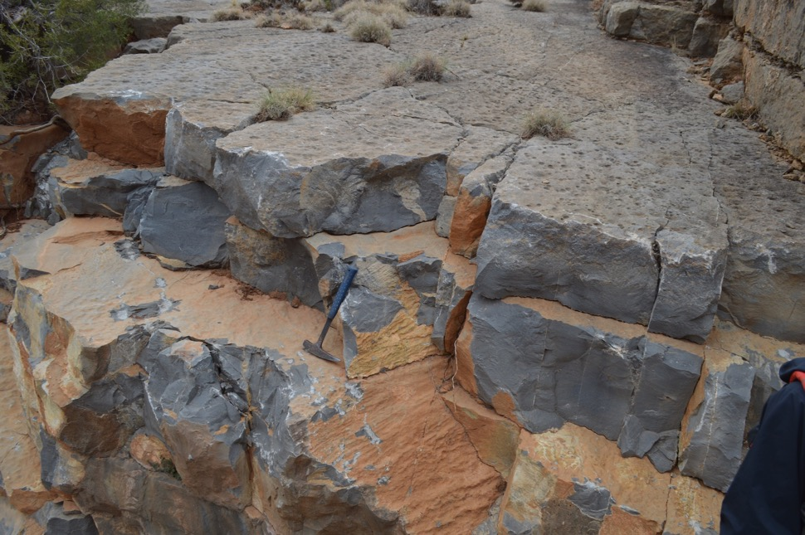
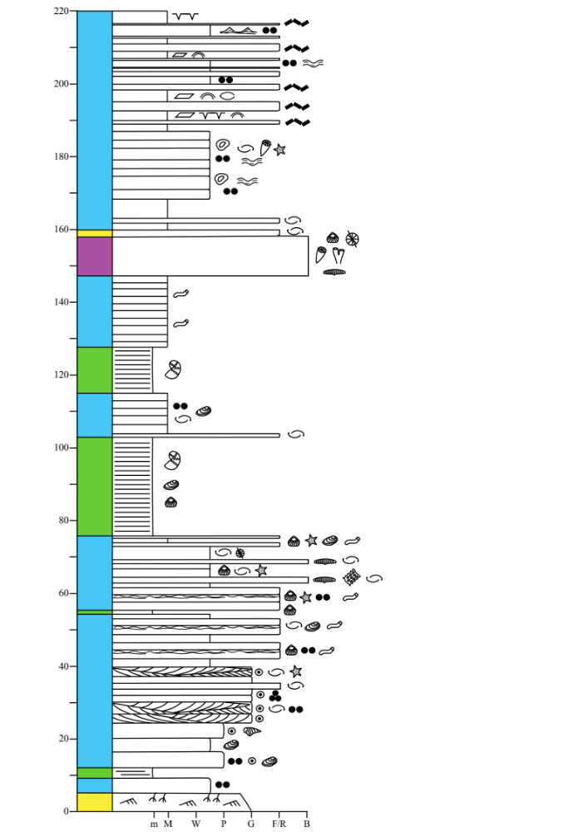
Unit 2a: Somalirhynchia member
Outcrop appearance (HS)
(2.19)
Several bed tops in unit 2 show additional structures. Try to identify these from these images.

Slide 3
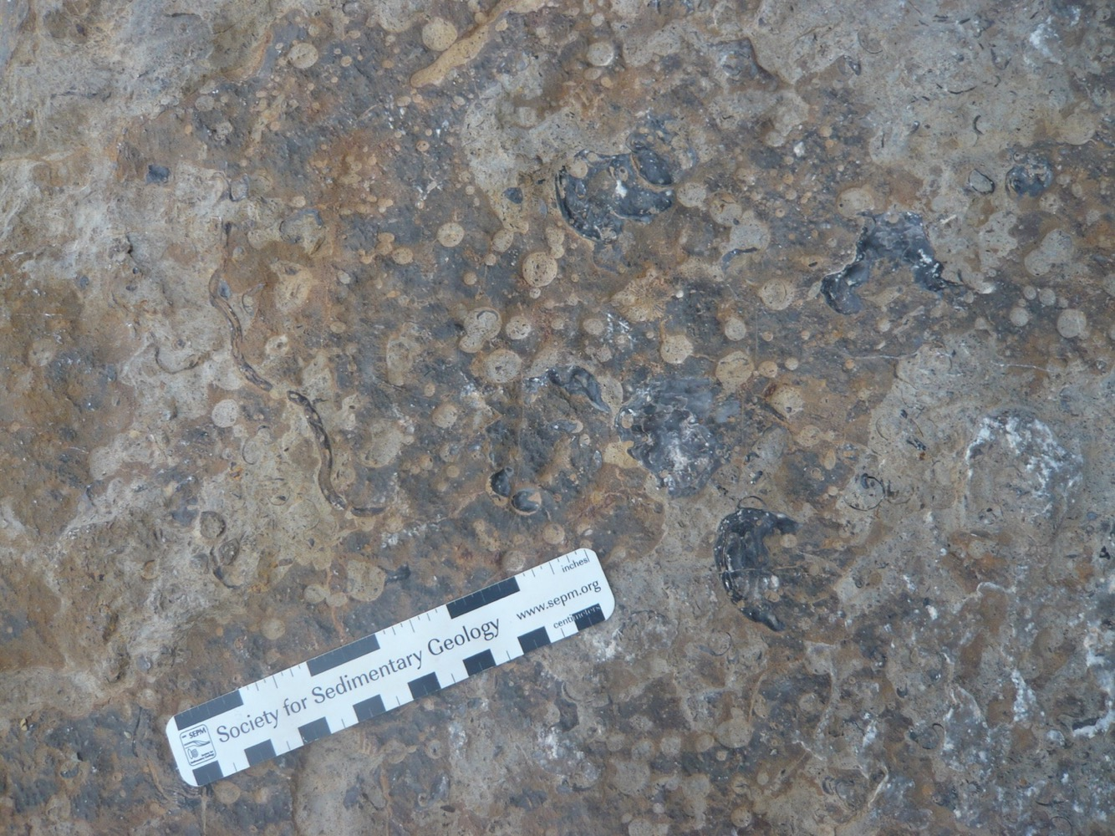
Unit 2a: Somalirhynchia member
(2.20)
Picture of a bedding plane.
What allochems and sedimentary structures can you identify on this bedding plane?

Slide 4
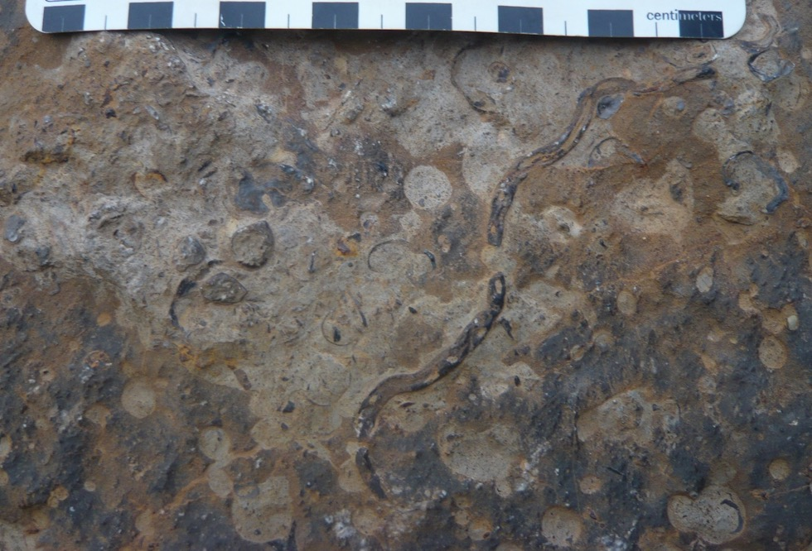
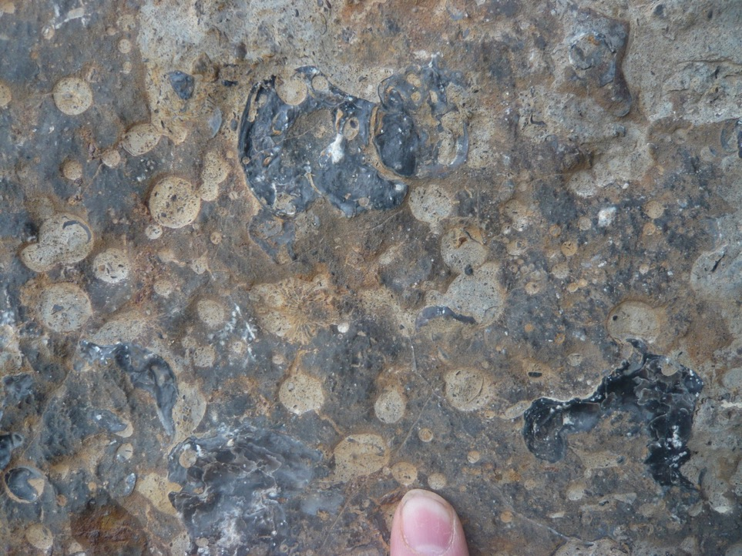
Unit 2a: Somalirhynchia member
(2.21)
What allochems and sedimentary structures can you identify on this bedding plane?
(2.22)

Slide 5
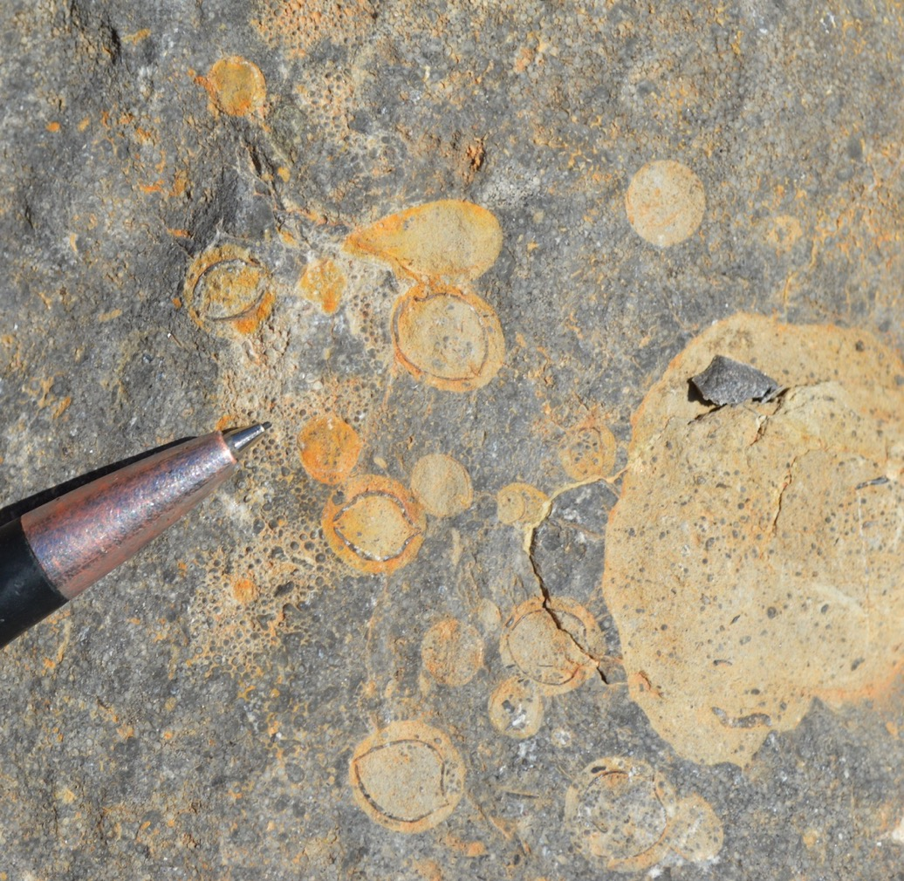
Unit 2a: Somalirhynchia member
(2.23)
What are the ring-like structures on this bedding plane?
What do these structures and allochems tell us about sedimentary processes affecting bedding planes?
What do these processes mean for relative sea level?

